Slide 1
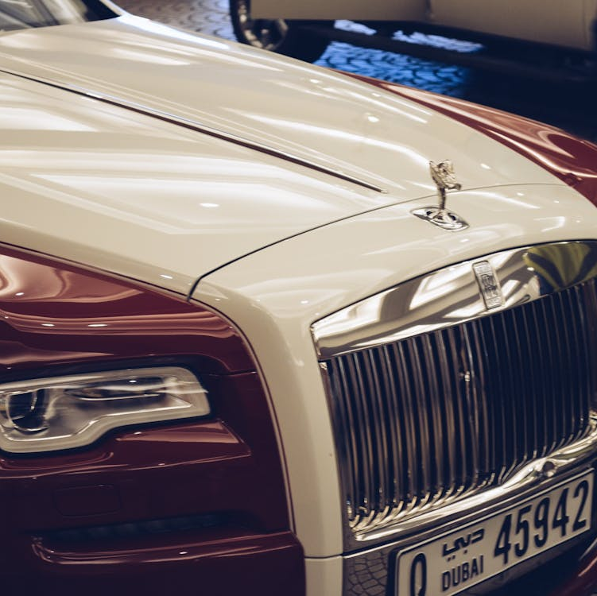
"Driving Luxury: A Deep Dive into Rolls-Royce’s STP Framework"

Slide 2
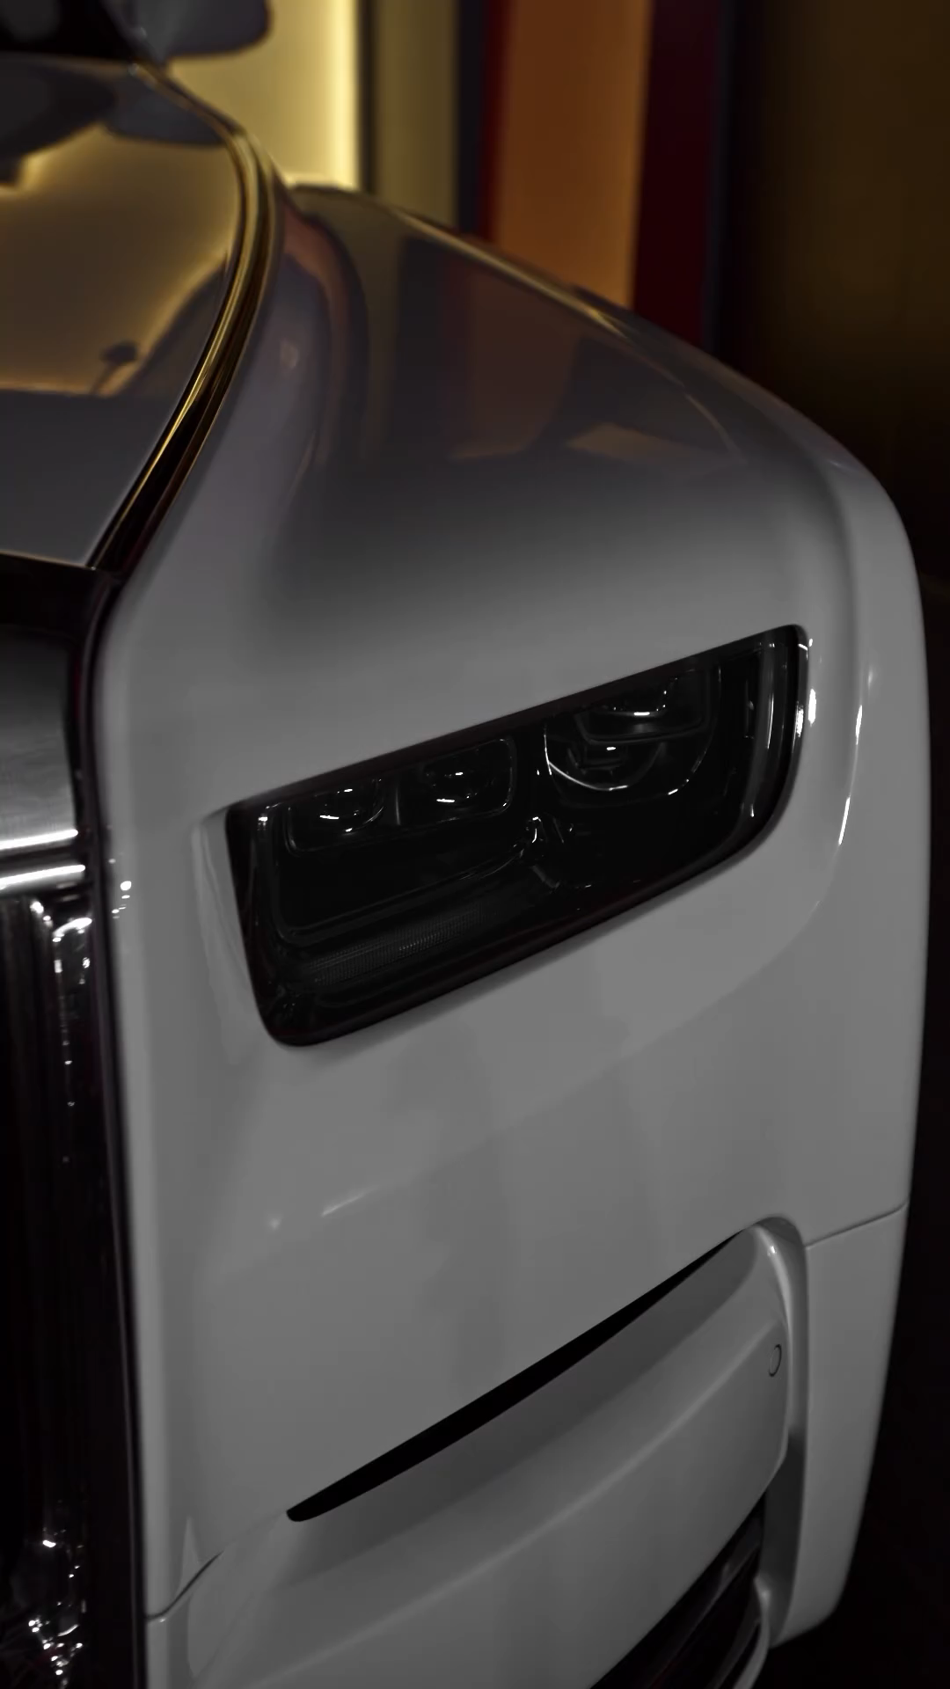
"𝐏𝐀𝐋𝐀𝐂𝐄 𝐎𝐍 𝐖𝐇𝐄𝐄𝐋𝐒"

Slide 3
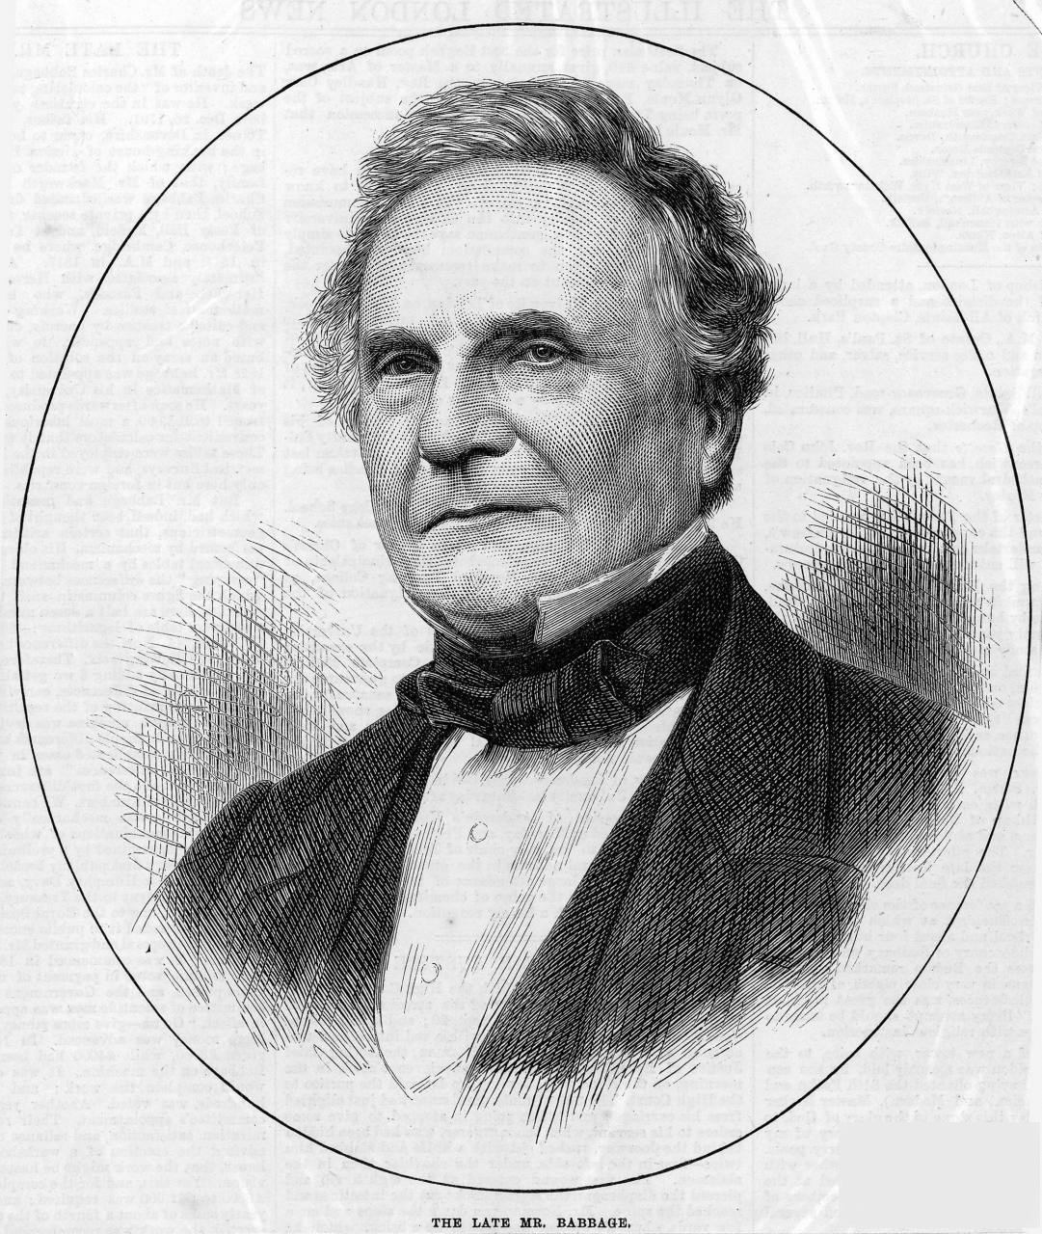
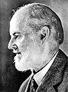
INTRODUCTION
Founded in 1904 by Charles Rolls and Henry Royce, this British marque began with a vision to build "the best car in the world." The result was a series of iconic vehicles that have become symbols of opulence and refined engineering. From the first Silver Ghost, to today’s stunningly bespoke Phantom and Cullinan, Rolls-Royce has continuously set the benchmark for automotive excellence. Rolls-Royce’s approach to marketing is as meticulously crafted as its products. The brand’s allure lies in its blend of rich heritage, exclusive customization, and cutting-edge technology. Every Rolls-Royce is a statement of personal achievement and an emblem of unparalleled luxury.

Slide 4

"STP ANANLYSIS OF ROLLS ROYCE"
SEGMENTATION-
Market segmentation is to divide the market into distinct groups of buyers who have different need, characteristics, or behaviour. Roll Royce as a brand has been clever in delivering market excellence by segmenting the market.
Demographic Segmentation:
Income: The Rolls-Royce targets the segment of people who have a very high income and can afford a costly car.
Occupation: Rolls-Royce motors also check out the customer’s occupation who have a reputation and fame with his occupation.
Psychographic Segmentation:
Social Class: Rolls-Royce Ghost targets the upper uppers social class people
Life style: Rolls-Royce targets the persons whose lifestyle is very showy and rich.

Slide 5
Behavioral Segmentation:
Loyalty Status: Rolls-Royce motor car company’s main targeted segment is the regular and loyal users
Attitude Toward Product: it target the segment of buyers who have a positive and enthusiastic attitude towards Rolls-Royce.
Geographic segmentation:
Country: Rolls-Royce has targets just developed and first world countries for Marketing
City: Rolls-Royce mainly markets their cars in cities where rich people lives.

Slide 6
TARGETING-
Target market is a set of buyers sharing common needs or characteristics that company decided to serve. Rolls Royce is a long standing symbol of status and aristocracy.
Some target areas of rolls royce are-
• Rolls-Royce targets a wide variety of customers for its integrated power systems.
• Target audience are Affluent people who value exclusivity, grandeur, and superb craftsmanship
• It targets Accomplished professionals, Business owners and High-net-worth individuals.
• They also cater to the needs of the aviation industry
• Rolls-Royce captures the interest of luxury enthusiasts worldwide.
• The target audience seeks not just transportation but a unique experience

Slide 7
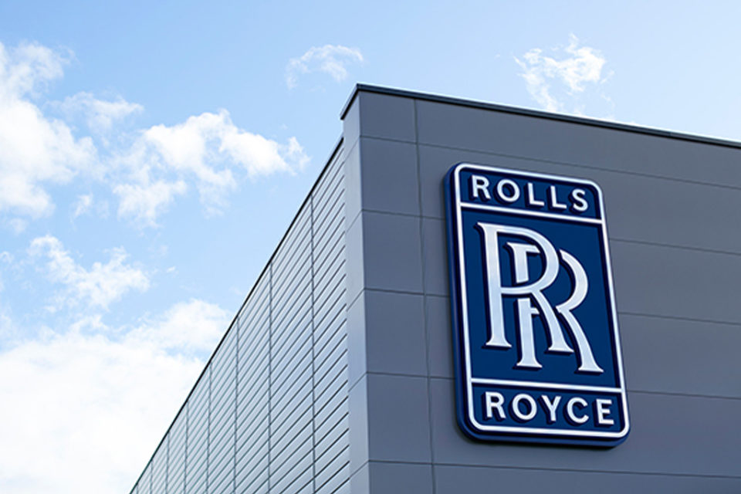
POSITIONING-
Rolls-Royce is the epitome of luxury and craftsmanship, offering bespoke, handcrafted automobiles that embody timeless elegance, exceptional performance, and unparalleled exclusivity.
Key Positioning Elements:
•Luxury and Exclusivity: Rolls-Royce emphasizes its position as a luxury brand, offering vehicles that are highly sought-after and limited in production.
•Craftsmanship and Quality: The brand highlights the meticulous craftsmanship and attention to detail that go into each vehicle, emphasizing its commitment to quality.
•Timeless Elegance: Rolls-Royce positions itself as a brand that transcends trends, offering vehicles with classic designs that are timeless and enduring.
•Exceptional Performance: While not primarily known for its raw speed, Rolls-Royce emphasizes the smooth, refined driving experience and powerful performance of its vehicles.
By positioning itself in this way, Rolls-Royce appeals to affluent individuals who are seeking a luxury automobile that is both a status symbol and a work of art.

Slide 8

STRENGTHS & WEAKNESSES ANALYSIS
Rolls Royce Strengths :
Strong Brand Equity
Iconic Designs
High quality materials & Craftsmanship
Customization Options
Strong Dealer Network

Slide 9

Rolls Royce Weaknesses :
High Price Point
Narrow Market Segment
High maintenance cost
Limited Product Range
Environmental Concerns

Slide 10
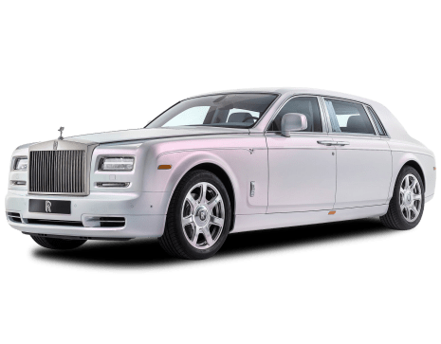
PRODUCT ANALYSIS
Rolls-Royce Products Overview
Rolls-Royce Motor Cars:
Phantom- Flagship luxury sedan, iconic styling, supreme comfort, Cutting-edge V12, Sumptuous interior, Shooting Star Headliner with customizable fiber-optic lights.
Ghost - Modern luxury car, driver-focused, Smooth V12, Touchscreen infotainment system, Bespoke Audio system.
Wraith- Grand tourer coupe combining luxury and performance, 6.6-liter twin-turbocharged V12, 624 horsepower, Elegant design with modern performance.
Cullinan- First SUV, combines luxury with off-road capability, V12, Elevated riding position, Sophisticated air suspension.

Slide 11

New Goods:
Electric Vehicles: Environmentally friendly luxury combining advanced electric technology with Rolls-Royce craftsmanship.
Urban Mobility Vehicle: Exclusive urban vehicle for prestigious commuting.
Areas for Improvement and Gaps:
- Acceptance of Hybrid and Electric Technologies:
Market Transition to Sustainability:
- Rising demand for eco-friendly luxury cars.
- Regulatory pressures for electrification.
Brand Perception and Innovation:
- Trailing in EV technology compared to competitors.
- Competitors like Tesla, Porsche, and Lucid Motors setting new benchmarks.
Technology Integration:
- R&D Investment: Less focus on electric and hybrid technologies.
- Infrastructure: Need for advanced charging networks and supportive infrastructure.

Slide 12

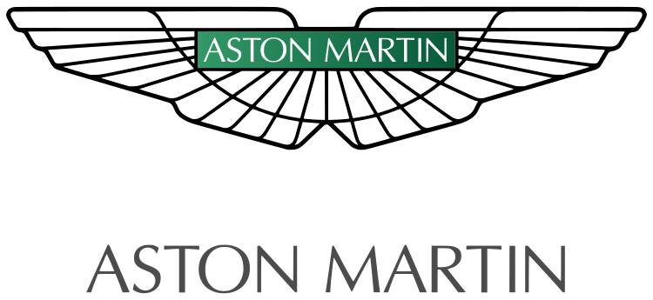
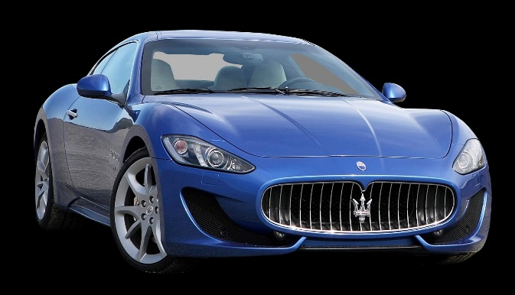
COMPETITOR ANALYSIS
Rolls-Royce Competitor Analysis - Luxury Automotive Sector
Key Competitors:
Bentley Motors: Direct competitor; focuses on bespoke craftsmanship and high-performance luxury.
• Aston Martin: Blends performance with elegance, challenging Rolls-Royce’s . refined image.
Maserati: Offers Italian design and distinctive style, emphasizing the driving experience.

Slide 13
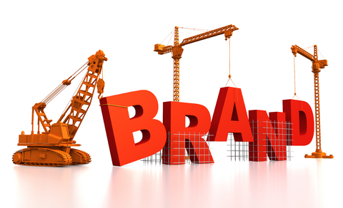

Competitive Factors:​
Brand Heritage: Rolls-Royce’s unmatched reputation in luxury and quality.​
Product Offering: Ultra-luxury vehicles with extensive customization options.​
Pricing Strategy: Premium pricing aligns with the brand’s luxury positioning.​
​
Strategic Insights:​
Brand Prestige: Leverage heritage and quality to reinforce leadership in luxury.​
Market Diversification: Explore new markets and enhance product lines to mitigate sector.​

Slide 14

RECOMMENDATIOS
Strategic Recommendations for Rolls-Royce
Expand into Emerging Markets: Target high-growth regions like China and India with tailored, ultra-personalized models.
Adopt Eco-Luxury: Launch a cutting-edge electric vehicle line and enhance digital experiences with virtual showrooms and AR customization.
Enhance After-Sales Services: Offer exclusive packages and premium maintenance options.
Forge Strategic Partnerships: Collaborate with other luxury brands to elevate the Rolls-Royce experience.
Emphasize Craftsmanship: Highlight Rolls-Royce’s heritage and craftsmanship in marketing to differentiate from competitors.
Engage Younger Audiences: Use compelling brand stories and influential ambassadors to attract a younger, affluent demographic.

Slide 15
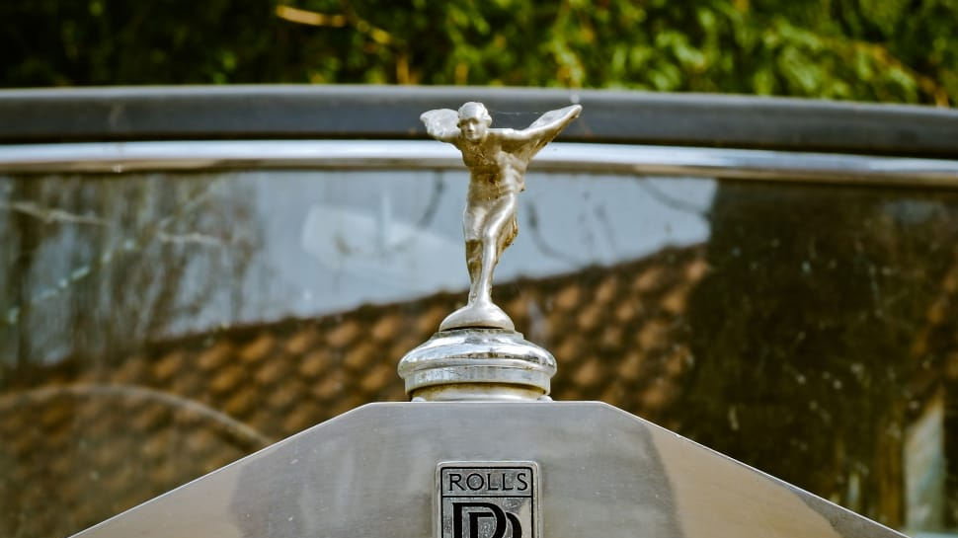
THANK YOU !!

